Slide 1

Mrs. Ramo’s and Mrs. Cruz’s Second Grade

Slide 2

About Mrs. Ramo
I have been teaching in different capacities for 14 years. I have my Bachelor’s degree in Child and Family Development and my Master’s Degree in Elementary Education. I have 3 beautiful children (Madelyn 11, Isabel 9, and Grayson 4) and a husband (Devin 36). We have an old man dog named Raja and a crazy puppy named Millie. We also have a leopard-spotted gecko named Rigby, a cat named Playdough, and a fish named fish. I love to shop, talk, garden, drink coffee, and cheer on the Dawgs!

Slide 3

About Mrs. Cruz
I’ve been teaching for 11 years. I taught Pre-K, Kindergarten, and 2nd
Grade. I taught in immersion, multi-age, and inclusion classrooms. I have a Master’s Degree in Education.

Slide 4

Communication
Mrs. Cruz: Josnil.Cruz@icsatlanta.org
Mrs. Ramo: christen.ramo@icsatlanta.org
Blog: You can access all grade level blogs at icsatlanta2ndgrade.edublogs.org

Slide 5

Communication (continued)
The agenda will be used for daily communications (e.g. to inform your child’s teacher about a Dr. appointment the next day, to let the teacher know about a change in transportation, etc).
The teacher will also use the agenda to communicate daily behavior and will send home reminders to parents in the agenda, so please check it every day and initial to show that you’ve read!
Your child’s completed work will be sent home on Fridays in the orange folder. Please take out and look over all materials sent home. Please take the time and talk to your child about the work he/she completed in class, and let us know if you have any questions.

Slide 6

Communication (Continued)
Please check the blog often as you will find the following information:
Weekly Newsletters
Upcoming Events
Homework/Vocabulary Lists
Pictures and Videos (Password protected)
PYP Information
Sign Up Link for Lunch with Your Child
icsatlanta2ndgrade.edublogs.org

Slide 7

Classroom Community
As a group, we strive to be caring, open-minded, inquirers, communicators, principled, reflective, knowledgeable, balanced, and thinkers, and we make sure to allow our friends the opportunity to be the same.

Slide 8

Class Subjects
Program of Inquiry/POI (PYP)
Math
English/Language Arts
Phonics
P50 (50 minutes of fun and engaging mathematics instruction)
Specials (PE, Keyboarding, Art, and Music)

Slide 9

Phonics
Phonics First Reading and Spelling system, an International Multisensory Structured Language Education Council (IMSLEC) Accredited multi-sensory learning program, is a multisensory, systematic, structured, sequential, phonics-based, direct-instruction approach to teaching readers.
Rooted in the Orton-Gillingham principles of instruction, Phonics First uses scientifically research-based learning strategies to teach students systematic processes for decoding (reading) and encoding (spelling). Students who use the Phonics First system make significant gains in reading and spelling while building a lifelong understanding of the structure of language.
Example of OG 3 Part Drill: 3 Part Drill

Slide 10
English Class Goals
Students will:
Listen to, read, and recall important information from texts including fables and folktales from diverse cultures.
Know and apply 2nd grade level phonics skills including distinguishing between long and short vowels, vowel teams, prefixes and suffixes.
Write informative/explanatory, opinion, and narrative pieces including revising and editing
Understand collective nouns, irregular plural nouns, reflexive pronouns, irregular verbs, and distinguish between adjectives and adverbs.
Our 2nd Grade ELA standards can be found HERE.

Slide 11

Writing - English
Opinion Writing: writing students state an opinion, supply reasoning that supports the opinion using linking words (e.g., because, and, also) to connect their opinion and their reasoning, and provide a concluding statement or section.
Informative/Explanatory Texts: writing in which students use facts and definitions to develop points, and provide a concluding statement or section.
Narratives: writing in which students recount a well-elaborated event or short sequence of events including details to describe actions, thoughts, and feelings and using temporal words to signal event order, and provide a sense of closure.

Slide 12
Reading - Spanish
2nd Grade students will learn how to read in Spanish, ask and answer questions to understand key details (who, what, where, when, why) recount stories, fables, and folktales and determine central message.
They will also compare and contrast important, points and key details, decode words with common prefixes and suffixes, and describe how characters respond to major events and challenges
We will work on acquiring Spanish vocabulary first and foremost.
Please practice myON at home. (Clever)

Slide 13

Writing - Spanish
2nd Grade students are required to write simple sentences and towards the end of the year a small paragraph (5+ sentences) to a topic that is familiar. Focus on punctuation, capitalization, spacing, and penmanship (correct letter formation, legibly writing upper and lower case letters).
Also, With guidance and support, use a
variety of tools, including digital and
collaboration with peers, to produce writing.

Slide 14

Math
Number Sense
  Place Value
  Rounding
  Addition, Subtraction
Problem Solving
Graphing/Data Analysis
Measurement, Time
Money
Geometry
  Identifying and Partitioning Shapes

Slide 15

What is IB?
- IB stands for International Baccalaureate
- We are an IB World school. We were authorized over the summer.
The International Baccalaureate (IB) aims to develop inquiring, knowledgeable
and caring young people who help to create a better and more peaceful
world through intercultural understanding and respect...
- The Primary Years Programme (PYP) encourages students across the world to
become active, compassionate and lifelong learners who understand that
other people, with their differences, can also be right.
- The PYP is a program for our students in Kindergarten to our 5th grade.

Slide 16
What is IB?
What does it mean for your child?
      - more transdisciplinarity in his/her learning: more connections to what he is learning in the other subject areas
      - learner profiles/traits and attitudes that will help him/her better
      himself as a student but also as a person, as a citizen of the world

Slide 17
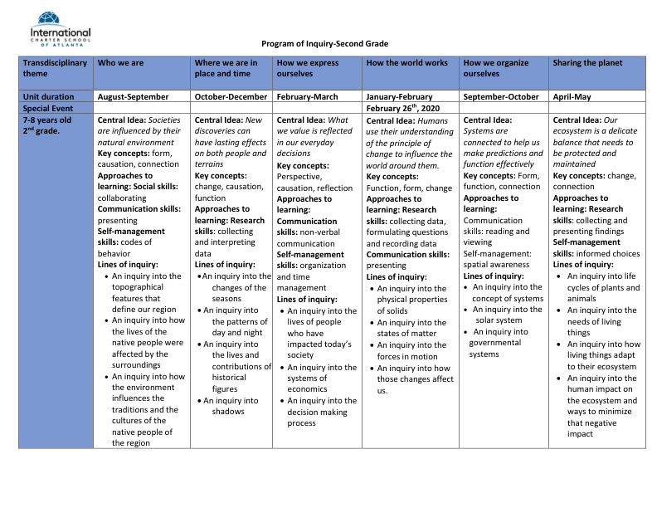

Slide 18
Power50 (P50)
Daily Math enrichment or tutoring from 1:10-2:00 pm
Students will be working in English with different teachers to help them
        develop their math skills
        further their math skills
        review targeted math skills
We have seen great Math scores on the Milestones due to this P50 Math focus and both teachers and students are enjoying themselves doing hands on math.

Slide 19
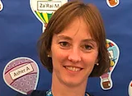
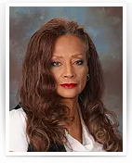
About Mrs.Shepherd and Ms. Beauchamps
I am Mrs. Shepherd and will be your students physical education teacher. I am a native German speaker and graduated from KSU with a Bachelor of Science in Health and Physical Education. I have worked in the past as an Moid teacher as well as taught Adapted Pe. In Germany I received my associate degree and finished with a “Certificate for the Hotel and Catering Business” working in hotels in Germany and the US.
I love teaching our students about how important physical movement is for their bodies and that it directly relates to health. Healthy body , healthy mind!
Ms. Beau is our parapro, who also by the way teaches martial art on the weekend. She has great knowledge and is an instructor in martial arts, self defense and loves children. She has a black belt in Japanese karate, black belt in Muay Thai Kickboxing and self defense, and a blue belt in Brazilian Jiu Jitsu!!!
Ms Shepherd
Ms Beauchamp ------->

Slide 20
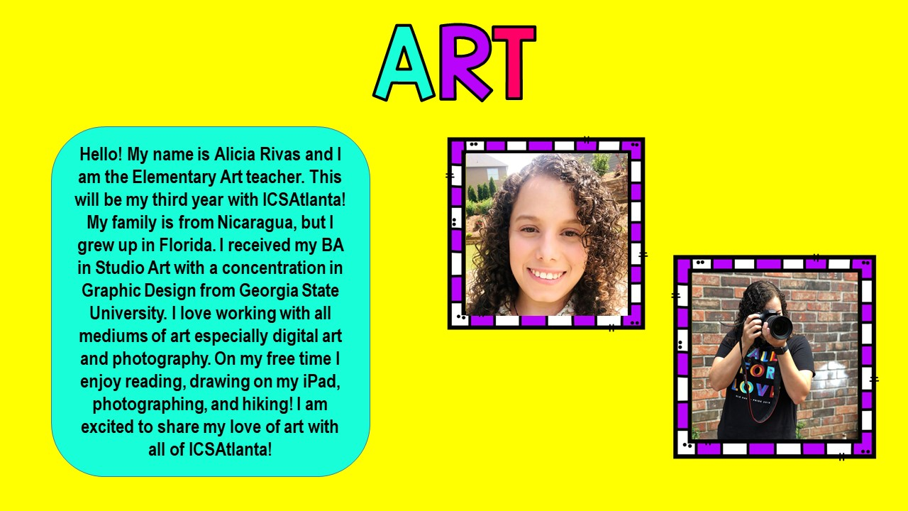

Slide 21
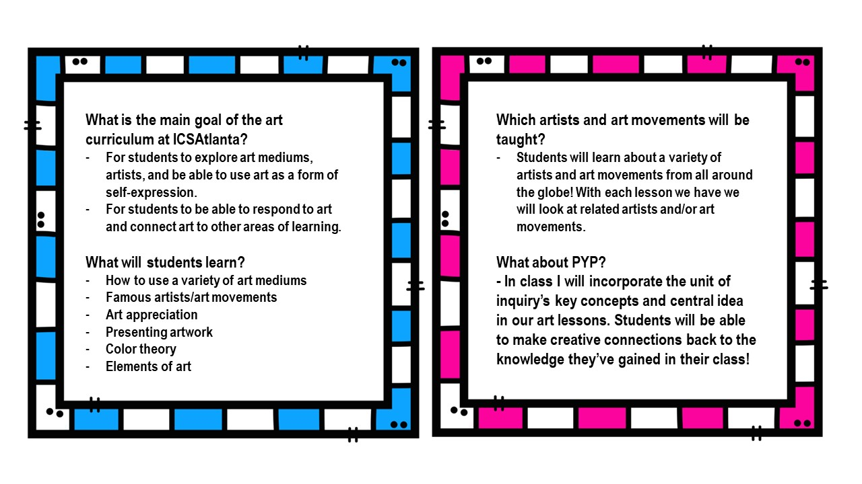

Slide 22
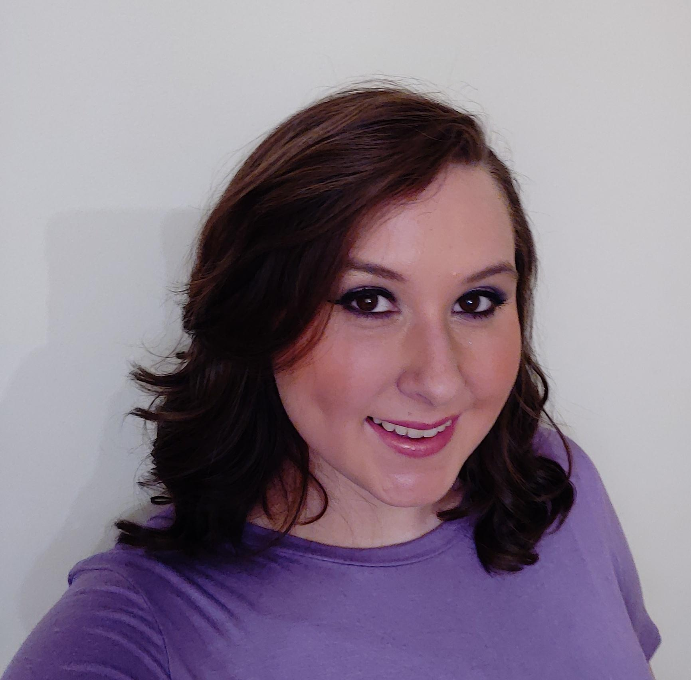
Music
EDUCATION
Rome High School
Rome, GA
Graduation May 2010
Jacksonville State University
Jacksonville, AL
August 2010 - December 2015
Bachelor of Arts in
Music Education
As a JSU student, I played trumpet in the Marching Southerners and sang Soprano in A Capella Choir, Chamber Singers, and Show Choir. I also participated in many productions with the Jacksonville Opera Theatre.
In my spare time, I love to watch TV, play video games on my phone, and cuddle with my 2 cats.
Ms. Lacy Taylor
Teaching Experience
2019-2020 is my first year with ICSAtlanta, but I taught elementary music (K-4) in Oxford, Alabama for 3 years prior. I also had the opportunity to co-direct an elementary choir.
FAVORITES
Color: purple Chocolate: Snickers
Food: corn (any kind) Candy: Gummies
Animal: butterfly

Slide 23

Music Curriculum
Quaver Music is an excellent education resource that I will be using this year to help your students learn about and enjoy music.
Standards:
National Association for Music Education (NAfME)
Georgia Standards of Excellence (GSE)
Georgia Performance Standards (GPS)
Students will learn to:
Read music,
Compose music,
Appreciate music through all cultures,
Play various musical instruments,
Dance & move appropriately to music,
And so much more.
PYP: Every student that attends music at ICSAtlanta will have multiple opportunities in every lesson to connect to the units of inquiry via the key concepts, as well as the other academic subjects.
Music is at the heart of all we do.
Located at the crossroads of Music Row in Nashville, TN, QuaverMusic was founded on the power of music. Our dedicated staff of over 100 employees works full time to develop music-based teaching resources quickly and stay on the cutting-edge of education and technology.
Technology is what we know.
We have been developing online curricula for over 7 years. We’re not just digitizing textbooks, but creating truly interactive content optimized for classroom bandwidth along with backup resources for Internet down days.
More info? Visit www.quavermusic.com

Slide 24

Keyboarding Without
Tears
All 2nd and 3rd grade students will take KWT as a special areas class once a week.
Students follow along at a self guided pace.
The KWT program is filled with fun, engaging games and activities that help students to improve their typing skills.
We will also have Digital Citizenship lessons throughout the year to teach students how to be safe and responsible when they are online.
Why? It will benefit students to be better able to answer questions on the Milestones test but also as they get older and are expected to do more assignments and work on the computer.

Slide 25
Online Resources
Clever: Mobymax, MyOn, and Linguascope are available through the Clever website. Students have been assigned one login username and password for this site. Students will utilize Clever for homework online and/or practice at home or at school
Login info:
  https://clever.com/in/international-charter-school-of-atlanta874cb2e000143dfdf
  Username: Student ID # (on parent portal)
  Password: learn123
  In clever, Linguascope: password: learn

Slide 26
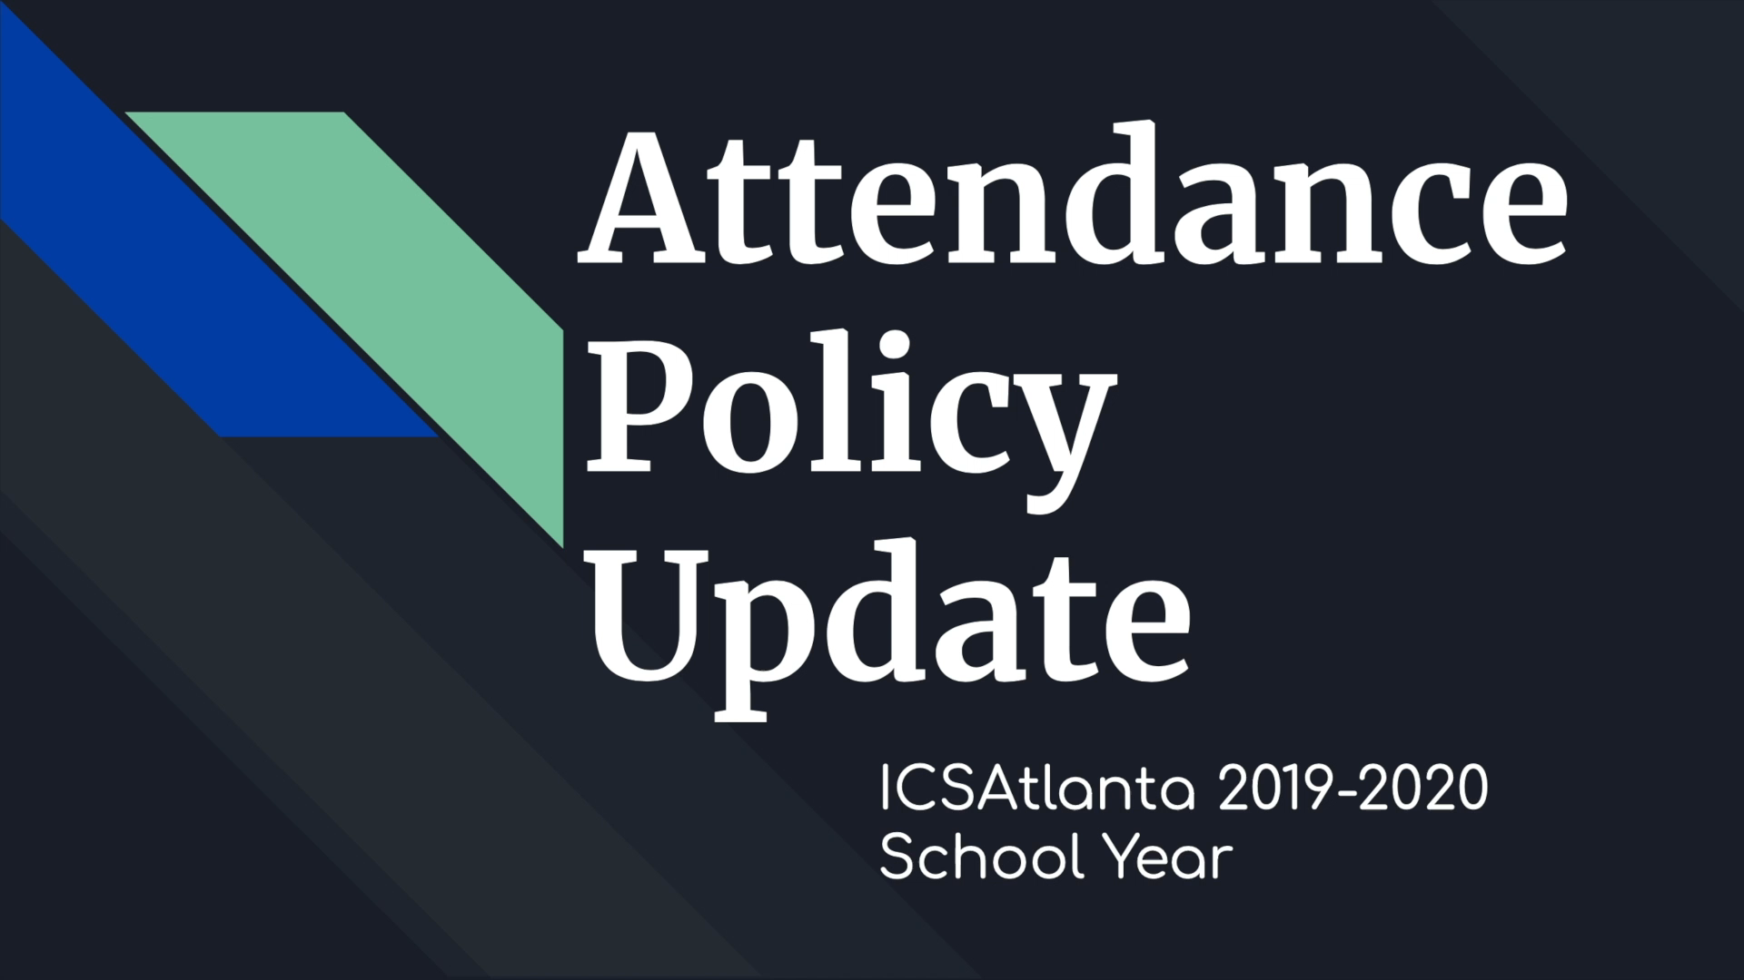
Attendance

Slide 27
Tardiness
School starts at 7:40 A.M. If you arrive after 7:40AM, please check in at the school office before coming to class.
If you need to check your student out of school early, you must do so by 2PM Mondays, Tuesdays, Thursdays, and Fridays and 11:30AM Wednesdays.

Slide 28
Volunteering
We need volunteers! If you would like to volunteer to be a room parent, volunteer for an event, etc, please let Mrs. Ramo or Ms. Cruz know! Also, don’t forget to fill out all appropriate volunteer paperwork with the front office as well as complete the mandated reporter training.

Slide 29
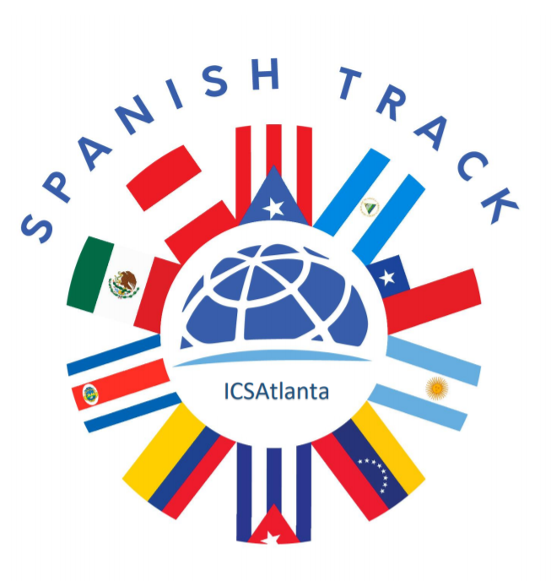
Spanish Heritage:
Save the date!
October 5th, 3 to 6pm
Song: “La Gozadera”
Gente de Zona
Dress in jeans and a white shirt
Volunteers: Set the first meeting!

